Slide 1

AI and Machine Learning for IoT Big Data

Slide 2
Case study 2

Slide 3
Outline of the lecture
The popular website kaggle.com is famous for its AI competitions: datasets are presented with a challenge, usually predictions
Here we explore the “NYC Taxicab” dataset and its associated competition: predict taxi trip durations from spatial and temporal conditions

Slide 4
Where are we in the Course?
Introduction: Background of IoT, Big Data, AI
Collect, analyze data from IoT on a large scale
Elements and practice of statistics
AI methods for data science
Getting further with AI: internal workings
Practical usage of AI for Big Data from IoT
Moving into the real world

Slide 5
Lecture 10: Geospatial Big Data
Case study: New York City taxi trips
The taxicab fare data
Analyzing with Spark and Scala
Finding patterns
Resolving geographic information
Conclusions

Slide 6
Taxicab data with Spark and Python
In “Advanced Analytics with Spark”, Chapter 8 deals with analyzing the “NYC taxicab” data.
By using the powerful GeoJSON Java library in Scala, it is possible to analyze the dataset using domain knowledge about the various boroughs of New York City.
In this lecture we start from the Kaggle dataset for the taxicab data, with Kaggle kernels.
Notes:
Remind students to review the task using the textbook AAS.
We use Python here, but they are encouraged to try running the Scala code from AAS.

Slide 7
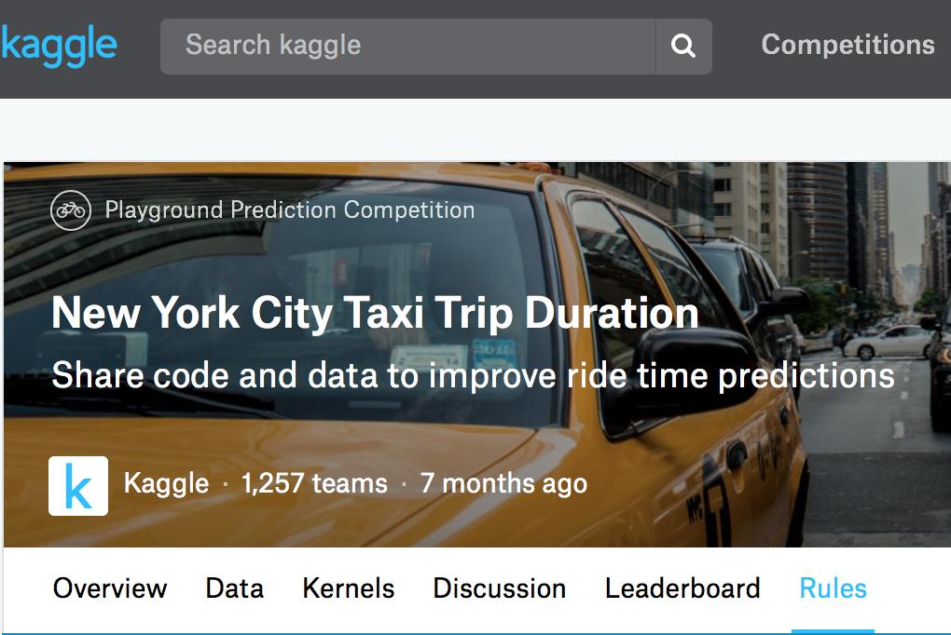
The second source: competition on Kaggle
Notes:
Remind students of the value of trying out the datasets and scripts on Kaggle.
Each of them should try to find an example directly related to their interests.

Slide 8
Kaggle Taxicab competition
We get two datasets: train has temporal and spatial info + trip duration test missing trip duration - we have to predict it
The prediction is not trivial, traffic depends on location, date, time, other random factors
Notes:
Discuss why trip duration might be different for similar distances

Slide 9
Dataset Overview
id - a unique identifier for each trip
vendor_id - a code indicating the provider associated with the trip record
pickup_datetime - date and time when the meter was engaged
dropoff_datetime - date and time when the meter was disengaged
passenger_count - the number of passengers in the vehicle (driver entered value)
pickup_longitude - the longitude where the meter was engaged
pickup_latitude - the latitude where the meter was engaged
dropoff_longitude - the longitude where the meter was disengaged
dropoff_latitude - the latitude where the meter was disengaged
store_and_fwd_flag - This flag indicates whether the trip record was held in vehicle memory before sending to the vendor because the vehicle did not have a connection to the server - Y=store and forward; N=not a store and forward trip
trip_duration - duration of the trip in seconds
Two data items are present in the training set but missing from the test set:
dropoff_datetime - date and time when the meter was disengaged
trip_duration - duration of the trip in seconds
Notes:
We choose only a few data items; what others could be significant?

Slide 10
Read in and take a look
# #Train and Test Datasets
df_train = pd.read_csv("train.csv")
df_test = pd.read_csv("test.csv")
df_train.head()
Table 1
df_train.head()
Out[5]:
id vendor_id pickup_datet | ime dropoff_datetime | passenger_count pickup_longitude pickup_latitude dropoff_longitude dropoff_latitude store_and_fwd_flag trip_duration
0 id2875421 2 2016-03-14 | 17:24:55 2016-03-14 | 17:32:30 1 -73.982155 40.767937 -73.964630 40.765602 N 455
1 id2377394 1 2016-06-12 | 00:43:35 2016-06-12 | 00:54:38 1 -73.980415 40.738564 -73.999481 40.731152 N 663
2 id3858529 2 2016-01-19 | 11:35:24 2016-01-19 | 12:10:48 1 -73.979027 40.763939 -74.005333 40.710087 N 2124
3 id3504673 2 2016-04-06 | 19:32:31 2016-04-06 | 19:39:40 1 -74.010040 40.719971 -74.012268 40.706718 N 429
4 id2181028 2 2016-03-26 | 13:30:55 2016-03-26 | 13:38:10 1 -73.973053 40.793209 -73.972923 40.782520 N 435
Notes:
The rest of the lecture should be used as a preview of the interactive exercise.

Slide 11
Check statistics
df_train.describe()
Table 1
 | vendor_id | passenger_count | pickup_longitude | pickup_latitude | dropoff_longitude | dropoff_latitude | trip_duration
count | 1.458644E+06 | 1.458644E+06 | 1.458644E+06 | 1.458644E+06 | 1.458644E+06 | 1.458644E+06 | 1.458644E+06
mean | 1.53495E+00 | 1.66453E+00 | -7.397349E+01 | 4.075092E+01 | -7.397342E+01 | 4.07518E+01 | 9.594923E+02
std | 4.987772E-01 | 1.314242E+00 | 7.090186E-02 | 3.288119E-02 | 7.064327E-02 | 3.589056E-02 | 5.237432E+03
min | 1E+00 | 0E+00 | -1.219333E+02 | 3.43597E+01 | -1.219333E+02 | 3.218114E+01 | 1E+00
25% | 1E+00 | 1E+00 | -7.399187E+01 | 4.073735E+01 | -7.399133E+01 | 4.073588E+01 | 3.97E+02
50% | 2E+00 | 1E+00 | -7.398174E+01 | 4.07541E+01 | -7.397975E+01 | 4.075452E+01 | 6.62E+02
75% | 2E+00 | 2E+00 | -7.396733E+01 | 4.076836E+01 | -7.396301E+01 | 4.076981E+01 | 1.075E+03
max | 2E+00 | 9E+00 | -6.133553E+01 | 5.188108E+01 | -6.133553E+01 | 4.392103E+01 | 3.526282E+06
Notes:
The rest of the lecture should be used as a preview of the interactive exercise.

Slide 12
Distribution of the trip_duration
plt.figure(figsize=(10,10))
plt.scatter(range(len(df_train["trip_duration"])), np.sort(df_train["trip_duration"]))
plt.xlabel('index')
plt.ylabel('trip_duration in seconds')
plt.show()
Notes:
The rest of the lecture should be used as a preview of the interactive exercise.
Call attention to the poor information content: almost everything is hidden, because of the outliers

Slide 13
Data cleanup
The trip duration data has extreme outliers
We need to make a decision about removing them
First, let’s remove the most “unplausible” data
# #Removing the outliers in the dataset
df_train = df_train[df_train["trip_duration"] < 500000]
Notes:
The rest of the lecture should be used as a preview of the interactive exercise.

Slide 14
Distribution of the trip_duration
plt.figure(figsize=(10,10))
plt.scatter(range(len(df_train["trip_duration"])), np.sort(df_train["trip_duration"]))
plt.xlabel('index')
plt.ylabel('trip_duration in seconds')
plt.show()
Notes:
The rest of the lecture should be used as a preview of the interactive exercise.
Still poor info…

Slide 15
Data cleanup 2
Better but still cannot see the actual distribution
Let’s remove trips up to 2 hours
# #Removing the outliers in the dataset
df_train = df_train[df_train["trip_duration"] < 7200]
Notes:
The rest of the lecture should be used as a preview of the interactive exercise.
2 hours: good choice?

Slide 16
Distribution of the trip_duration
plt.figure(figsize=(10,10))
plt.scatter(range(len(df_train["trip_duration"])), np.sort(df_train["trip_duration"]))
plt.xlabel('index')
plt.ylabel('trip_duration in seconds')
plt.show()
Notes:
The rest of the lecture should be used as a preview of the interactive exercise.
What kind of statistical distribution this looks like?

Slide 17
Exploring the distances between the pickup and dropoff lat/log coordinates
We use the “haversine” library for geospatial distance calculation
from haversine import haversine
def calculate_haversine_distance(var_row):
return haversine((var_row["pickup_latitude"], var_row["pickup_longitude"]),
(var_row["dropoff_latitude"], var_row["dropoff_longitude"]), miles = True)
# #Calculating the Haversine Distance
# #The haversine formula determines the great-circle distance between two points on a sphere
# #given their longitudes and latitudes.
df_train["haversine_distance"] = df_train.apply(lambda row: calculate_haversine_distance(row), axis=1)
Notes:
Compare with other geographical libraries.
How about Google Maps API?

Slide 18
The distance distribution
We have added a new column to the frame
df_train["haversine_distance"].describe()
Table 1
count 1.458640e+06
mean 2.138039e+00
std 2.669720e+00
min 0.000000e+00
25% 7.654260e-01
50% 1.300971e+00
75% 2.408013e+00
max 7.710647e+02
Name: haversine_distance | dtype: float64
Notes:
The rest of the lecture should be used as a preview of the interactive exercise.

Slide 19
Plot of the haversine distance vs the trip duration
plt.figure(figsize=(10,10))
sns.regplot(x="haversine_distance", y="trip_duration", data=df_train)

Slide 20
Cleaning up the data
We look at the outliers in the distances:
Trips over 100 miles can also be removed…
df_train[df_train["haversine_distance"] > 100]
Table 1
 | id | vendor_id | pickup_datetime | dropoff_datetime | passenger_count | pickup_longitude | pickup_latitude | dropoff_longitude | dropoff_latitude | store_and_fwd_flag | trip_duration | haversine_distance
114376 | id1311087 | 1 | 2016-02-29 12:16:29 | 2016-02-29 18:47:09 | 3 | -75.455917 | 39.803932 | -73.796021 | 40.707726 | N | 23440 | 107.515425
184925 | id2306955 | 1 | 2016-05-07 18:58:53 | 2016-05-07 19:12:05 | 1 | -72.809669 | 51.881084 | -73.987228 | 40.750599 | N | 792 | 771.064665
275644 | id0978162 | 1 | 2016-02-24 16:20:59 | 2016-02-24 16:35:34 | 4 | -75.354332 | 34.712234 | -73.834923 | 32.181141 | N | 875 | 195.585348
Notes:
Is a 100 miles trip realistic or not?

Slide 21
Plot of the haversine distance vs the trip duration
plt.figure(figsize=(10,10))
sns.regplot(x="haversine_distance",y="trip_duration",data=df_train[df_train["haversine_distance"] < 100])
Notes:
Why is the distribution so scattered?

Slide 22
Distance vs trip time?
There does not seem to be any clear correlation
The distribution is all over the place
It is unclear what causes the drastic differences
Prediction will be difficult…

Slide 23
Attempt at Keras prediction
from keras.models import Sequential
from keras.layers import Dense
from keras.wrappers.scikit_learn import KerasRegressor
from sklearn.model_selection import cross_val_score
from sklearn.model_selection import KFold
from sklearn.preprocessing import StandardScaler
from sklearn.pipeline import Pipeline
XX = df_train[['passenger_count','haversine_distance','pickup_hour']].values
YY = df_train[‘trip_duration’]
X = XX[:10000]
Y = YY[:10000]
Notes:
From this point, the notebook is just one example; during the exercise the class should try to work out a better procedure!

Slide 24
Attempt at Keras prediction
# define base model
def baseline_model():
# create model
model = Sequential()
model.add(Dense(3, input_dim=3, kernel_initializer='normal', activation='relu'))
model.add(Dense(1, kernel_initializer='normal'))
# Compile model
model.compile(loss='mean_squared_error', optimizer='adam')
return model
# fix random seed for reproducibility
seed = 7
np.random.seed(seed)
# evaluate model with standardized dataset
estimator = KerasRegressor(build_fn=baseline_model, epochs=100, batch_size=5, verbose=0)
Notes:
The rest of the lecture should be used as a preview of the interactive exercise.

Slide 25
Attempt at Keras prediction
kfold = KFold(n_splits=10, random_state=seed)
results = cross_val_score(estimator, X, Y, cv=kfold)
print("Results: %.2f (%.2f) MSE" % (results.mean(), results.std()))
estimator.fit(X, Y)
Ypr = estimator.predict(X)
import matplotlib.pyplot as plt
%matplotlib inline
Notes:
The rest of the lecture should be used as a preview of the interactive exercise.

Slide 26
Attempt at Keras prediction
plt.xlim(0,3000)
plt.plot(Y,Ypr,'b.')
Notes:
The rest of the lecture should be used as a preview of the interactive exercise.
Comment on the prediction quality. What is the effect of using only a small subset of the data?

Slide 27
Discussion
Our simple-minded prediction, while better than just using the distance, is obviously poor
Let us explore what others have done so far:
Exploratory Data Analysis
Prediction
Assignment: choose one kernel, clone it, re-create the analysis, then try to go to the next step

Slide 28
References
Kaggle NYC Taxicab https://www.kaggle.com/kartikkannapur/nyc-taxi-trips-exploratory-data-analysis
NYC taxicab data on Github https://github.com/andresmh/nyctaxitrip

Slide 29
Summary of the lecture
We have started exploring a dataset with temporal and spatial information, resulting from complex processes (city travels).
We can expect finding similar difficulties in IoT Big Data: outliers, non-trivial dependencies, and need for domain knowledge for meaningful analysis.

